Slide 1
Pointers
Objective Oriented Programming
Spring 2024

Slide 2
References
Chapter 14, D.S. Malik, C++ Programming, 5th edition
Chapter 8, Dietel & Dietel, C++ how to Program, 7th edition

Slide 3
Computer Memory
Each byte in memory has an address just as they are for houses
If we have 1 MB of memory, the highest addresses are in range 0 to 1,048,575
The program when loaded into memory occupies a certain range of these addresses
Every variable and function has some address

Slide 4
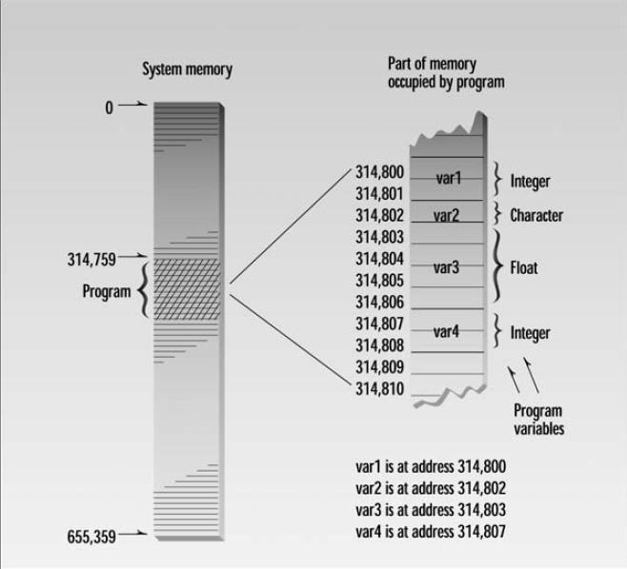
Taken from Ch. 10, Pointers, Object Oriented Programming in C++, Robert Lafore

Slide 5
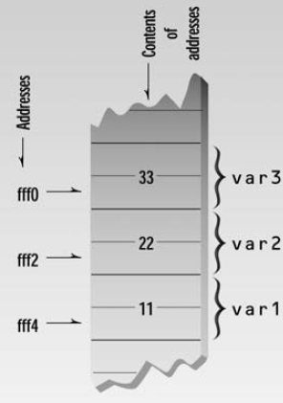
The Address-of Operator &
#include <iostream> using namespace std; int main() { int var1 = 11; int var2 = 22; int var3 = 33; cout <<&var1<<“\n”; cout<<&var2<<“\n”; cout<<&var3<<“\n”; return 0; }
Each location in memory has some address and some content(Value)

Slide 6
The actual addresses occupied by the variables in a program depend on many factors
Computer the program is running on
The size of the operating system
Whether any other programs are currently in memory

Slide 7
What is a pointer?
A variable that can hold address
Declaration:
dataType * pointer name;
int * p;
int n=10;
p=&n;
Asterik means pointer to
dataType of a pointer is the dataType of the variable this pointers is pointing to.
0x100
0x100
10
p
n

Slide 8
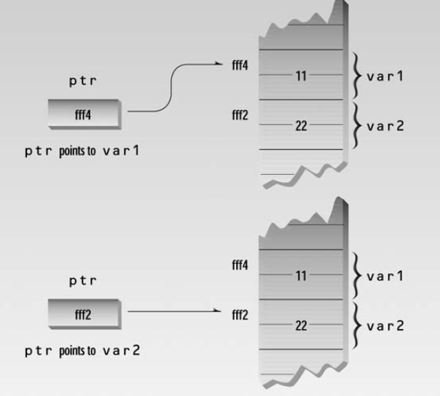
int main()
{
int var1 = 11;
int var2 = 22;
cout << &var1 << &var2 ;
int* ptr;
ptr = &var1;
cout << ptr << endl;
ptr = &var2;
cout << ptr << endl;
return 0;
}

Slide 9
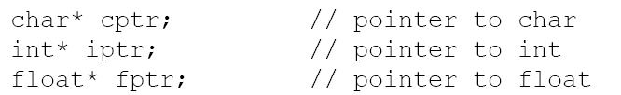


Examples
// p is pointer and q is not a pointer
// both p and q are pointers

Slide 10
Constant Pointer
Its value cannot be changed
int * const ptr = & x;
ptr= &y … NOT ALLOWED

Slide 11
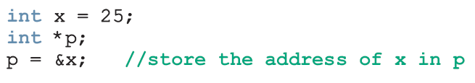

Dereferencing operator *
The * operator is called indirection operator or dereferencing operator
It refers to the object to which its operand (i.e., pointer) points
0x100
0x100
25
p
x
Output: 25
0x100
*p is equivalent to x
*p=21
0x100
21
p
x

Slide 12
cout<<x is equivalent to cout<<*p
x=x+1; is equivalent to *p = *p +1

Slide 13
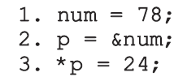
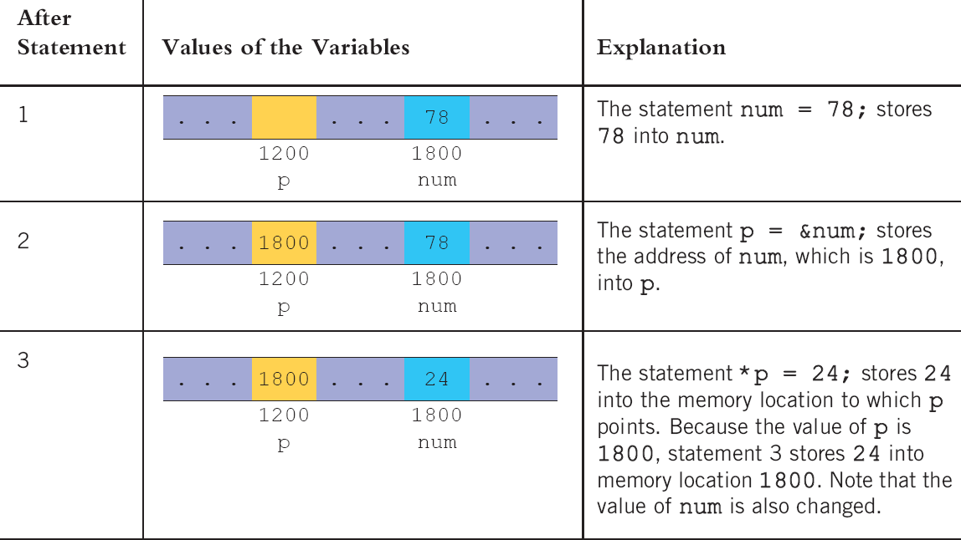
Example

Slide 14
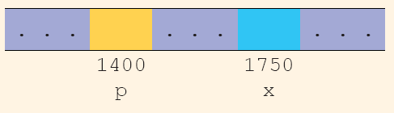

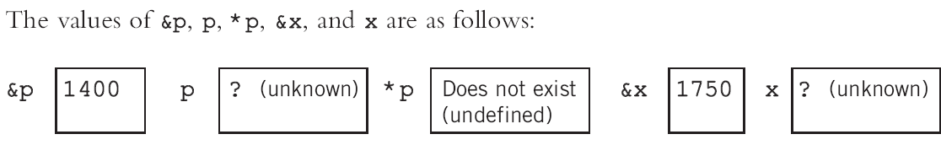

Example
Now following statements have been executed:
What are the values after third statement is executed?

Slide 15
Exercise

Slide 16
 | p | *p | q | *q | x(0xfff0) | y(0xfff4)
int *p = NULL;
int x = 1,y=2;
int *q = NULL;
p = &x;
(*p)++;
q = &y;
x = 5 + y;
*p = *p+2;
y = y * *p;
y = y + *q;
p = q;
y++;

Slide 17
 | p | *p | q | *q | x(0xfff0) | y(0xfff4)
int *p = NULL; | N | ? | ? | ? | ? | ?
int x = 1,y=2; | N | ? | ? | ? | 1 | 2
int *q = NULL; | N | ? | ? | N | 1 | 2
p = &x; | fff0 | 1 | ? | N | 1 | 2
(*p)++; | fff0 | 2 | ? | N | 2 | 2
q = &y; | fff0 | 2 | fff4 | 2 | 2 | 2
x = 5 + y; | fff0 | 7 | fff4 | 2 | 7 | 2
*p = *p+2; | fff0 | 9 | fff4 | 2 | 9 | 2
y = y * *p; | fff0 | 9 | fff4 | 18 | 9 | 18
y = y + *q; | fff0 | 9 | fff4 | 36 | 9 | 36
p = q; | fff4 | 36 | fff4 | 36 | 9 | 36
y++; | fff4 | 37 | fff4 | 37 | 9 | 37

Slide 18
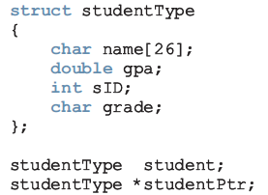

Pointer and structs

Slide 19
Pointers & Arrays

Slide 20
Array
Array name is an address
int array[10]={0,1,2,3,4,5,6,7,8,9};
cout<<array;
//What should be output?
cout<<*array;
Array is a constant pointer
We cannot point array to another variable
0 | 1 | 2 | 3 | 4 | 5 | 6 | 7 | 8 | 9
array

Slide 21
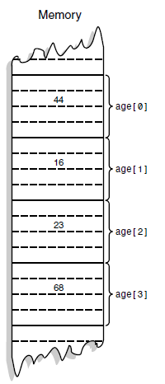
int age[4];
age+0
age+1
age+2
age+3

Slide 22
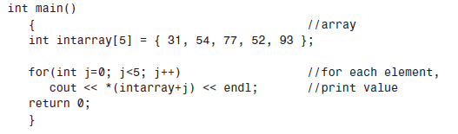
[ ] operator is also a dereferencing operator
It is equivalent to *(intarray+j)

Slide 23
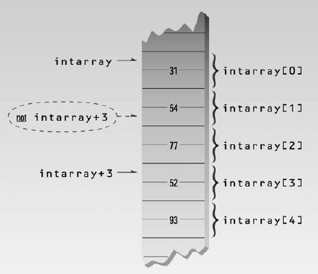

Slide 24
Pointer Arithmetic
When something is added to pointer, compiler checks the data type
int array[10];
*(array + 1) //access second element of array it is equivalent to array[1]
*(array + j) actually equal to
array + (j* sizeOf dataType)

Slide 25
Accessing array with pointer
int array[5]={10,12,14,16,18};
int *ptr;
ptr=array; // same as ptr=&array[0];
ptr=&array ; //wrong
ptr=&array[2];
*ptr=*ptr + 3;
ptr++;
cout<<*ptr;
cout<<*(ptr+1);
cout<< * (ptr-1);
ptr--;

Slide 26
Arrays & Pointers
Elements | 31 | 54 | 77 | 52 | 95
Indices | 0 | 1 | 2 | 3 | 4
Addresses | intarray | intarray+1 | intarray+2 | intarray+3 | intarray+4
int main()
{
int intarray[5] = { 31, 54, 77, 52, 93 };
for(int j=0; j<5; j++)
cout << intarray [ j ] << endl;
return 0;
}
Array name is a constant pointer
intarray has address of first location of array
We can also write *(intarray+j) to access element at loc# j

Slide 27
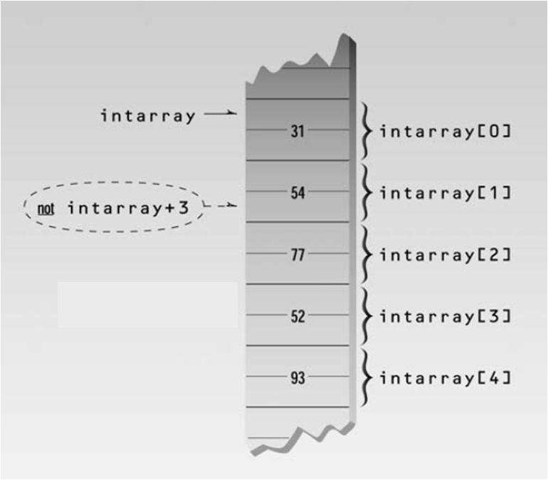
WHY

Slide 28
Pointer Arithmetic
intarray+1 actually means intarray + (1 * sizeof(int))
So intarray+1 will move directly to the location # 1 of array
Similary intarray+3 means intarray + (3 * sizeof(int)), intarray+3 will move directly to location # 3 (4th location)

Slide 29
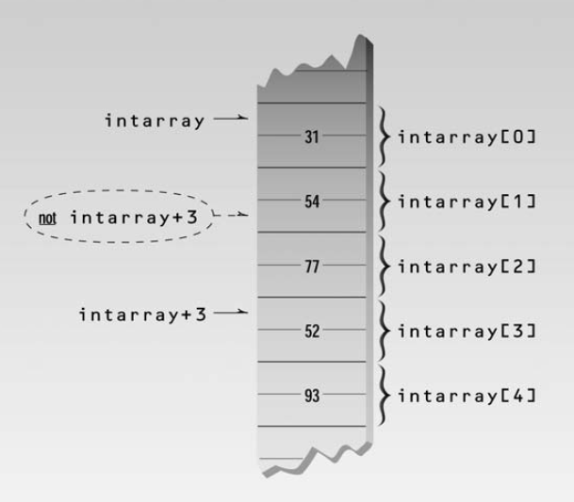

Slide 30
Can we do *(intarray ++)?
NO because intarray is a const pointer
But we can do this using a pointer
A simple pointer can point to an array
e.g.,
int * ptr;
int array[10];
ptr = array;
ptr has address of first location of array.

Slide 31
Printing Array using pointer
int main()
{
int intarray[5] = { 31, 54, 77, 52, 93 };
int *ptr;
ptr=intarray;
for(int j=0; j<5; j++)
{
cout << *( ptr+j ) << endl;
}
return 0;
}
*(ptrint + j) is equivalent to intarray[ j ]
C:\MinGW\bin>a
31
54
77
52
93
C:\MinGW\bin>
Same as cout<<*ptr++
We can also write ptr[j]
Because [ ] is also a de-referencing operator

Slide 32
Is this valid? ptr= & array;
What about this? ptr= & array[0];

Slide 33
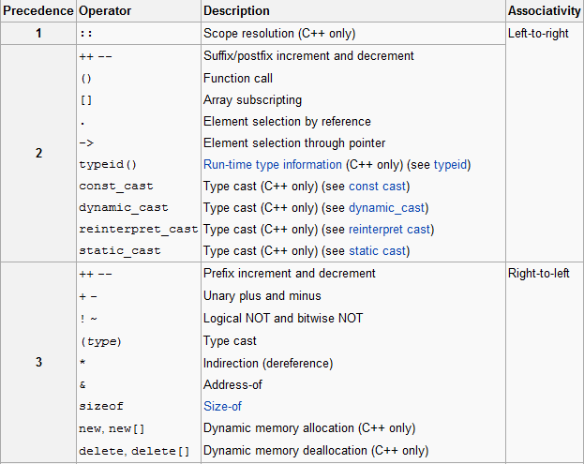
Precedence rules Source: Wikipedia

Slide 34
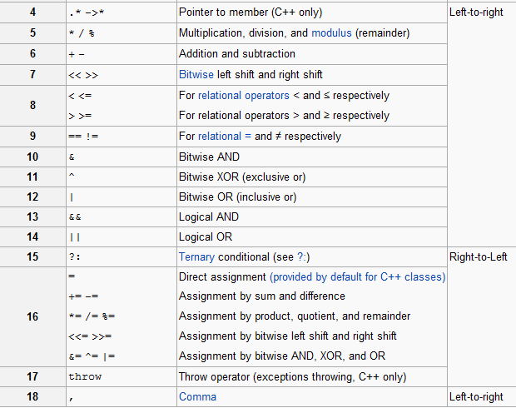

Slide 35
Example
#include <iostream>
using namespace std;
int main()
{
int x[4]={1,2,3,4};
int *p=x,y,z;
y=*++p;
z=*p++;
cout<<"\ny="<<y;
cout<<"\nz="<<z;
cout<<"\n*p="<<*p;
return 0;
}
C:\MinGW\bin>g++ a.cpp -o a.exe
C:\MinGW\bin>a
y=2
z=2
*p=3
C:\MinGW\bin>

Slide 36
Pointers & Arrays (Example)
void PrintArray(int Array[],int Size)
{
for (int i=0;i<Size;++i)
cout << Array[i] << " ";
cout << endl;
}
int main()
{
int arr[5] = {1,2,3,4,5};
int *ptr = arr; //which array element does ptr point to
//printing first time
PrintArray(arr,5);
ptr = ptr + 1; //where will ptr point now
*(ptr-1) = 10*ptr[-1]; //which arr element will be changed
*(ptr+2) = 10* *(ptr+2); //which arr element will be changed
//printing second time
PrintArray(arr,5);
ptr = ptr +2; //where is ptr now
ptr[-2] = ptr[-2] * 10; //what will this change?
//printing third time
PrintArray(arr,5);
return 0;
}
1 2 3 4 5
10 2 3 40 5
10 20 3 40 5

Slide 37
Returning pointer from a function (Example 1)
#include "iostream"
using namespace std;
#include <cstring>
int *larger(int *x, int *y)
{
if (*x>*y)
return x;
else return y;
}
int main()
{
int num1=12, num2=34;
int *z;
z=larger(&num1, &num2);
cout<<*z;
return 0;
}
NOTE: address returned must be the address of a variable in the calling function. It is an error to return a pointer to a local variable in the called function

Slide 38
Returning pointer from a function (Example 2)
dataType * functionName(parameters)
#include "iostream"
using namespace std;
#include <cstring>
char * myFunction(char a[], const int size)
{
char * temp=a;
int i;
for ( i=0;i<size; i++)
{
if (a[i]=='.')
break;
}
temp=temp+i+1;
return temp;
}
int main(){
char a[]= "Hello.World";
char * t;
t=myFunction(a,strlen(a)+1);
cout<<t;
return 0;
}
We cannot return an array but we can return a pointer

Slide 39
Struct Pointers
struct student{…}
student s1;
student *s2;
s2=&s1;
cout<<s2->name;
cout<<s2->age;

Slide 40
Array of Pointers
int * p[10];
p[i] is a pointer
int x=10;
p[0]=&x;

Slide 41
The Correct Place for “const”
pointer value cannot be changed now, i.e., we cannot do this:
x=&g;
int y=2;
int * const x=&y;
const int * z;
z=&y;
The value of the variable pointed by z cannot be changed through pointer i.e., we cannot do this
*z=32; but we can do this: y=32; directly

Slide 42
Pointers & functions

Slide 43
Argument pass by reference
#include <iostream>
using namespace std;
void centimize(double&); //prototype
int main()
{
double var = 10.0; //var has value of 10 inches
cout << “var = “ << var << “ inches” << endl;
centimize(var); //change var to centimeters
cout << “var = “ << var << “ centimeters” << endl;
return 0;
}
//--------------------------------------------------------------
void centimize(double& v)
{
v *= 2.54; //v is the same as var
}
OUTPUT:
var = 10 inches
var = 25.4 centimeters
Variable is passed by reference

Slide 44
Using Pointers in function arguments
Notice that we are passing the address of variable here
#include <iostream>
using namespace std;
void centimize(double*); //prototype
int main()
{
double var = 10.0; //var has value of 10 inches
cout << “var = “ << var << “ inches” << endl;
centimize(&var); //change var to centimeters
cout << “var = “ << var << “ centimeters” << endl;
return 0;
}
//--------------------------------------------------------------
void centimize(double* ptrd)
{
*ptrd = *ptrd * 2.54; //*ptrd is the same as var
}
OUTPUT:
var = 10 inches
var = 25.4 centimeters
Instead of passing variable by reference, we may use pointer

Slide 45
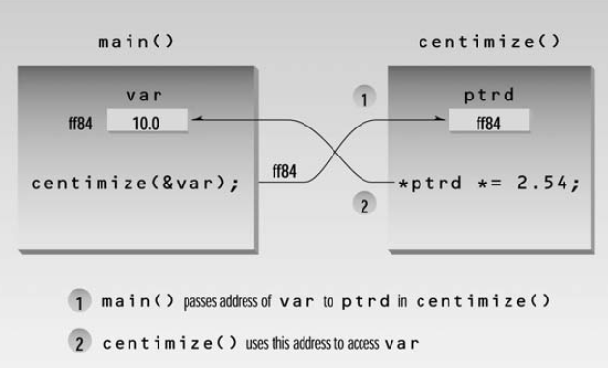

Slide 46
STUDY THIS CODE…t
void Increment(int *x)
{
*x = *x+1
}
void CallIncrement()
{
int a=10;
Increment(&a);
}
If we want to change the value of a we have to pass the address of a
Increment x
x and a are two different variables
x has the address of a
CallIncrement a
Slides from Dr. Mahreen Saeed’s Lecture

Slide 47
exercise

Slide 48
void quiteSimple(int *p, int *q)
{ *p = *p+1;
*q = *q + 5;
q = p;
(*p)++;
*q = *p + *q;
}
 | a | b | p | *p | q | *q
int a=0,b=0; | 0 | 0 | ? | ? | ? | ?
int *p=NULL,*q=NULL; | 0 | 0 | N | ? | N | ?
p=&a; q=&b;*p = 5; *q = 4; | 5 | 4 | &a | 5 | &b | 4
quiteSimple(p,q); | 14 | 9 | &a | 14 | &a | 14

Slide 49
void quiteSimple(int *p1, int *q1)
{ *p1 = *p1+1;
*q1 = *q1 + 5;
q1 = p1;
(*p1)++;
*q1 = *p1 + *q1;
}
 | a | b | p | *p | q | *q
int a=0,b=0; | 0 | 0 | ? | ? | ? | ?
int *p=NULL,*q=NULL; | 0 | 0 | N | ? | N | ?
p=&a; q=&b;*p = 5; *q = 4; | 5 | 4 | &a | 5 | &b | 4
quiteSimple(p,q); | 14 | 9 | &a | 14 | &a | 14

Slide 50
A COMMON BUG
int *p;
*p = 20;
The code looks quite harmless….what is wrong with it????
p should have been allocated memory or assigned a legal reference
Slides from Dr. Mahreen Saeed’s Lecture

Slide 51
Reference Parameter
int main()
{
int x=2;
increment(x);
}
void increment(int &y)
{
y=y+1;
}
Y is an alias of x, i.e., same memory location has two names
x
2
y
0xad1234
x
3
y
0xad1234

Slide 52
Pointer
int main()
{
int x=2;
increment(&x);
}
void increment(int *y)
{
*y=*y+1;
}
Y is pointing to x. y and x both have different memory locations
y
0xad1234
x
2
0xff457
0xad1234
y
0xad1234
x
3
0xff457
0xad1234

Slide 53
Pointer as function arguments void increment (int * p){*p=*p+1;}
Function call Type 1
int main()
{
int x=2;
int *q=&x;
increment(q);
cout<<x;
}
Function call Type 2
int main()
{
int x=2;
increment(&x);
cout<<x;
}

Slide 54
Passing pointer to functions (by value)
#include <iostream>
using namespace std;
void Swap(int * a, int * b)
{
int *temp;
temp=a;
a=b;
b=temp;
}
int main()
{
int x=2, y=4;
int *p, *q;
p=&x;
q=&y;
Swap(p,q);
cout<<*p<<" "<<*q;
return 0;
}
a
0xad1234
p
0xad1234
x
2
Tooba@2ba /c/mingw/bin
$ g++ swap_pointers.cpp -o a.exe
Tooba@2ba /c/mingw/bin
$ a
Before Swap() call
2 4
After Swap() call
2 4
Tooba@2ba /c/mingw/bin
$
0xff457
0xad1234
0xed100
b
0xae2345
q
0xae2345
y
4
0xef250
0xff459
0xae2345
p
0xad1234
x
2
0xff457
0xad1234
q
0xae2345
y
4
0xff459
0xae2345

Slide 55
Passing pointer to functions (by reference)
Tooba@2ba /c/mingw/bin
$ g++ swap_pointers.cpp -o a.exe
Tooba@2ba /c/mingw/bin
$ a
Before Swap() call
2 4
After Swap() call
4 2
Tooba@2ba /c/mingw/bin
$
#include <iostream>
using namespace std;
void Swap(int * &a, int * &b)
{
int *temp;
temp=a;
a=b;
b=temp;
}
int main()
{
int x=2, y=4;
int *p, *q;
p=&x;
q=&y;
Swap(p,q);
cout<<*p<<" "<<*q;
return 0;
}
p or a
0xad1234
x
2
0xff457
0xad1234
q or b
0xae2345
y
4
0xff459
0xae2345
p
0xad1234
x
2
0xff457
0xad1234
q
0xae2345
y
4
0xff459
0xae2345

Slide 56
Pointers and C-strings
#include <iostream>
using namespace std;
int main()
{
char str1[] = “Defined as an array”;
char* str2 = “Defined as a pointer”;
cout << str1 << endl; // display both strings
cout << str2 << endl;
// str1++; // can’t do this; str1 is a constant
str2++; // this is OK, str2 is a pointer
cout << str2 << endl; // now str2 starts “efined...”
return 0;
}

Slide 57
int main()
{
void dispstr(char*); //prototype
char str[] = “Hello World”;
dispstr(str); //display the string
return 0;
}
//--------------------------------------------------------------
void dispstr(char* ps)
{
while( *ps ) //until null character,
cout << *ps++; //print characters
cout << endl;
}
This function can be called as
disptr(“Hello World”);

Slide 58
char s1[]=“hello world”;
char *sptr=s1;
cout<<sptr; //prints whole array
cout<<*sptr; //prints first character
cout<<*(sptr+1);//prints character at loc 1

Slide 59
Struct pointers
struct studentType
{char name[26];
double gpa;
int sid;
char grade;
};
studentType student;
studentType *studentPtr;
studentPtr=&student;
studentPtr->gpa=3.5; //same as
*(studentPtr).gpa=3.5;

Slide 60
Dynamic Memory

Slide 61
Introduction
In many situations we don’t know how much memory we need until runtime
For example, we want to ask user to enter size of array and declare array of that size
cin>>size;
int array[size];
we cannot do this
But we can use dynamic memory

Slide 62
Dynamic Variable
Variable that are declared during program execution are called dynamic variables
new: to create dynamic variable
delete: to destroy dynamic variable

Slide 63
int *p;
int x=2;
p=&x; // NO NEW MEMORY IS CREATED
int *p;
p=new int;
A variable is created during program execution somewhere in memory and stores the address of the allocated memory in p
Now there is no label of the memory and we have to access it using pointer p
*p=23;
Or cin>>*p;

Slide 64
Example
int *x = NULL,*p = NULL;
x = new int;
p = new int;
*x = 10;
*p = 12;
x
p
x
p
x
p
10
12

Slide 65
Dynamic Array
int size;
cin>>size;
int *p;
p= new int[size];
for (int i=0; i<size; i++)
cin>>p[i];

Slide 66
Deleting Memory
“If your program reserves many chunks of memory using new, eventually all the available memory will be reserved and the system will crash. delete operator is used to return memory to the operating system”
To destroy single variable
delete pointervariable
To destroy dynamic array
delete []pointervariable

Slide 67
Deleting the memory doesn’t delete the pointer that points to it
It doesn’t change the address value in the pointer
However, this address is no longer valid
The memory it points to may be changed to something entirely different
Be careful that you don’t use pointers to memory that has been deleted

Slide 68
MEMORY LEAKS
x
p
int *x = NULL,*p = NULL;
x = new int;
p = new int;
*x = 10;
*p = 12;
p = x;
x
p
x
p
10
12
x
p
10
What happens to this location ???
It cannot be accessed
Cannot be used again
Creates a Memory leak
The memory that can no longer be accessed is called GARBAGE

Slide 69
DANGLING POINTER
x
p
int *x = NULL,*p = NULL;
x = new int;
p = new int;
*x = 10;
*p = 12;
p = x;
delete p
*x = 15
x
p
x
p
10
12
x
p
10
WHAT HAPPENS NOW????
Not only do we have a memory leak BUT also a dangling pointer ‘x’
this is given back to system
x
p
10
THIS WILL CRASH

Slide 70
Why would this code crash????
void ChangePointer(int *p)
{
p = new int;
*p = 10;
}
void CallChangePointer()
{
int *a = NULL;
ChangePointer(a);
*a = 1;
}
What is the problem in this code?

Slide 71
Shallow vs Deep Copy
int *first;
int *second;
first=new int[10];
second=first
first
12 | 23 | 34 | 23 | 23 | 35 | 56 | 33 | 66 | 4
second
Shallow copy: both pointers are pointing to the same memory

Slide 72
Shallow vs Deep Copy
int *first;
int *second;
first=new int[10];
second=new int[10];
for(int i=0; i<10; i++) {secon[i]=first[i];}
first
12 | 23 | 34 | 23 | 23 | 35 | 56 | 33 | 66 | 4
12 | 23 | 34 | 23 | 23 | 35 | 56 | 33 | 66 | 4
second
Deep copy: both pointers have their own data

Slide 73
What does following code do?
int s=3;
int *p[5];
for(int i=0;i<5;i++){
p[i]=new int[s];}
for(int i=0; i<5;i++){
for(int j=0; j<s;j++){
p[i][j]=2;}
}
for(int i=0; i<5;i++){
for(int j=0; j<s;j++){
cout<<p[i][j]<<" ";
}
cout<<endl;

Slide 74
Double pointers
Pointer to Pointer
What if we want to store the address of a pointer in some variable?
We can have a pointer pointing to a pointer
Double pointer is declared as:
dataType ** pointerName;

Slide 75

int i = 5, j = 6; k = 7; int *ip1 = &i, *ip2 = &j;
int **ipp;
ipp=&ip1;
*ip1 is 5
**ipp is 5
*ipp is value of ip1 i.e., address of I
ipp is address of ip1

Slide 76

If we do *ipp=ip2;
we've changed the pointer pointed to by ipp (that is, ip1) to contain a copy of ip2, so that it (ip1) now points at j

Slide 77

If we do *ipp = &k;
we've changed the pointer pointed to by ipp (that is, ip1 again) to point to k:

Slide 78
void ChangePointer(int **p)
{
*p = new int;
**p = 10;
}
void CallChangePointer()
{
int *a = NULL;
ChangePointer(&a)
}
If we want to change a we have to pass the address of a
ChangePointer p
p has the address of a which can now be changed by ChangePointer
CallChangePointer a
10
allocated by new

Slide 79
void ChangePointer(int **p)
{
*p = new int;
**p = 10;
}
void Increment(int *x)
{
*x=*x+1;
}
void CallChangePointer()
{
int *a = NULL;
ChangePointer(&a);
Increment(a)
}
Notice that we can simply pass a if we want to change the value of *a. The function increment does that
Increment x
to change the value pointed to by a we can simply pass a and not the address of a
CallChangePointer a
11
allocated by new

Slide 80
ARRAYS
void ChangeArray(int *a,int Size)
{
for (int i=0;i<Size;++i)
a[i] = i;
}
void AllocateArray(int **arr,int Size)
{
*arr = new int[Size];
}
void CallChangeArray()
{
int *myArr = NULL;
AllocateArray(&myArr,10);
ChangeArray(myArr,10);
}
AllocateArray arr
CallChangeArray myArrr
0 | 1 | 2 | 3 | 4 | 5 | 6 | 7 | 8 | 9
ChangeArray a
CallChangeArray myArrr
Note: to change the value inside myArr we have to pass the address of myArr and to change the elements of the array we can simply pass myArr

Slide 81
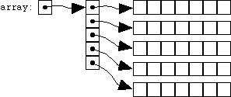
Why do we use ** pointers
Double pointers are helpful in declaring dynamic multidimensional arrays
int rows;
int cols;
cin>>rows>>cols;
int **array; //double pointer
array=new int*[rows];//dynamic array of pointers
for(int i=0;i<rows;i++)
{
array[i]=new int[cols];//each location is pointing to an array
}
This dynamic 2D array can be used in the same way as the static array
e.g.,
cin>>array[i][j]

Slide 82
Deleting dynamic 2D array
for (int i=0;i<rows;i++)
delete [ ] array[i];
delete [ ] array;

